Slide 1
Modeling of complex biological systems Developing a new parameter estimation method using
Gabriele Petznick, M.Sc.
September 26, 2012

Slide 2
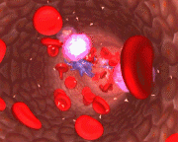
Modeling of complex biological systems Human blood coagulation
Endothelium
Goal: Quantitative, biologically realistic model
Hundreds of protein interactions
Blood flow effects
Spatiotemporal simulation of clot formation
Fibrinolysis
Inflammation
Coagulation Cascade
Platelets

Slide 3
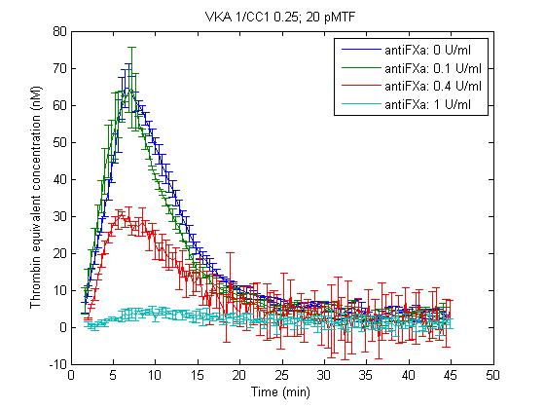
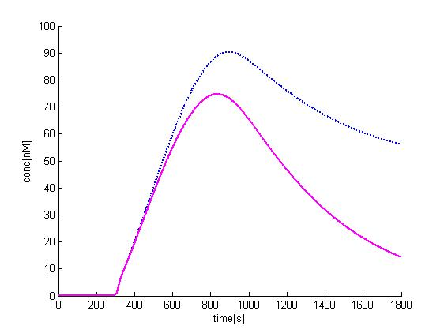
Modeling of complex biological systems Model characteristics
First order, non-linear ODE system
Known state variables (protein concentrations)
Hundreds of unknown reaction rate constants
Parameter estimation by fitting the model to
Experimental data
Theoretical constraints
In silico model of the human blood coagulation cascade, simulating the enzymatic processes in a thrombin generation assay (TGA).
Coagulation Cascade
BiG Grid allows to analyze the full model complexity

Slide 4
Modeling of complex biological systems Optimization methods
Developing a new parameter estimation method
Parameter estimation = Solving the inverse problem
Why?
Optimization methods minimize misfit between measured and simulated curves as a function of underlying model parameters
Integration of the ODE system for the entire duration of the measurement
Numerical integration requires up to 100% of the computation time
(for complex systems)
Method that only requires to integrate certain time windows of the ODE system

Slide 5
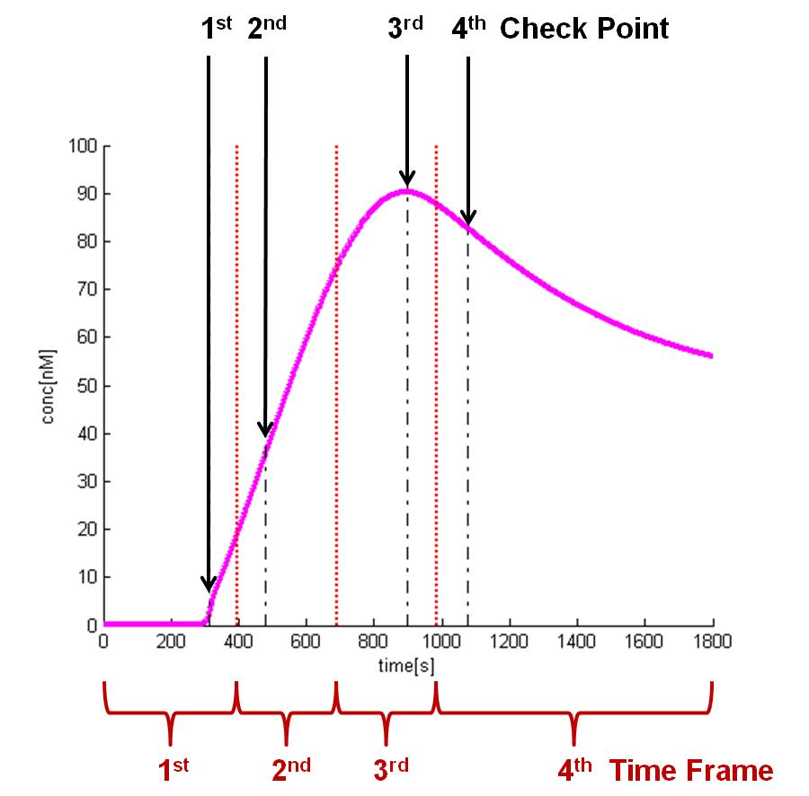
Modeling of complex biological systems Beam search framework
Beam search approach:
Left to right search along the time axis
Efficient pruning procedure rejects insufficient hypotheses earlier
Integrated search space expansion allows for the redirection into successful regions

Slide 6
Modeling of complex biological systems Beam search: principle
Initialization:
Random generation of hypotheses
Optimization loop (A):
Repeated until for sufficient no. of hypotheses are excepted
Time frame shift (B):
Pruning for fulfilling criteria of the following time frame
Surviving hypotheses are collected in the accepted population.
All following initializations:
Random generation of hypotheses
Offspring population

Slide 7
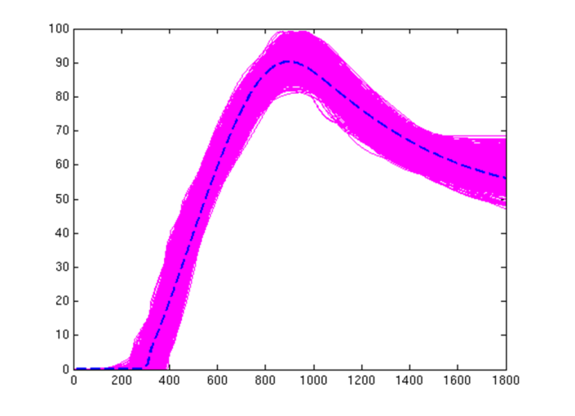
Modeling of complex biological systems Results
1. Framework suitable to find (enough) good hypotheses?
was used to:
Implement, test & optimize the framework
Run the simulation/optimization
1000 best-ranked hypotheses
Dotted line: target curve
Solid lines: accepted hypotheses

Slide 8
Modeling of complex biological systems Results
was used to:
2. Does using the frame work shorten the overall computation time?
Evaluate performance in terms of number of evaluated parameter sets and ODE time
 | I | g | e | r | ODEsec
Genetic Algorithm | 1 | 3.00*10^6 | 8.25*10^4 | 2.75*10^-2 | 5.40*10^9
 | 2 | 1.44*10^8 | 8.04*10^4 | 5.59*10^-4 | 2.58*10^11
 | 3 | 6.17*10^8 | 5.10*10^4 | 8.26*10^-5 | 1.11*10^12
 | all | 7.64*10^8 | 5.10*10^4 | 6.67*10^-5 | 1.38*10^12
Genetic Beam Search | 1 | 1.30*10^7 | 1.20*10^4 | 9.19*10^-4 | 5.38*10^9
 | 2 | 6.58*10^7 | 5.96*10^4 | 9.06*10^-4 | 3.80*10^10
 | 3 | 6.61*10^8 | 5.34*10^4 | 8.08*10^-5 | 3.23*10^11
 | all | 7.39*10^8 | 5.34*10^4 | 7.22*10^-5 | 3.62*10^11
I | Iteration
g | number of generated hypotheses
e | number of excepted hypotheses
r | ratio (e/g)
ODEsec | ODE seconds calculated
-75% of calculated ODE seconds
8

Slide 9
Modeling of complex biological systems
HTC BiG Grid
Jobs | CPU Usage
33718 | 37343 days
provided the resources needed to develop and evaluate a new parameter estimation method

Slide 12
The hemostatic system is a vital protective mechanism responsible for maintaining normal blood flow and preventing blood loss by sealing sites of injury in the vascular system. However, it must be controlled tightly so that neither prolonged bleeding nor redundant or excessive clotting occurs. In vivo the hemostatic balance exists under the influence of various cellular components as well as flow-mediated transport of the plasma coagulation factors. Until now the project mainly focused on developing and validating a mathematical model of the enzymatic coagulation cascade and fibrin formation. This in vitro scheme allows logical, effective laboratory-based screening for coagulation factor abnormalities. However, it lacks several aspects of the in vivo clotting physiology. Our aim is to provide a quantitative, biologically realistic model of all processes involved in hemostasis in vivo, to be able to predict the behavior of normal and pathologic states of the coagulation system. To reach that goal it is necessary to include the missing parts into our existing model. These parts include the interactions of proteins with membrane surfaces, the role of microparticles and cells, and the flow-mediated transport of all players in the system.

Slide 13
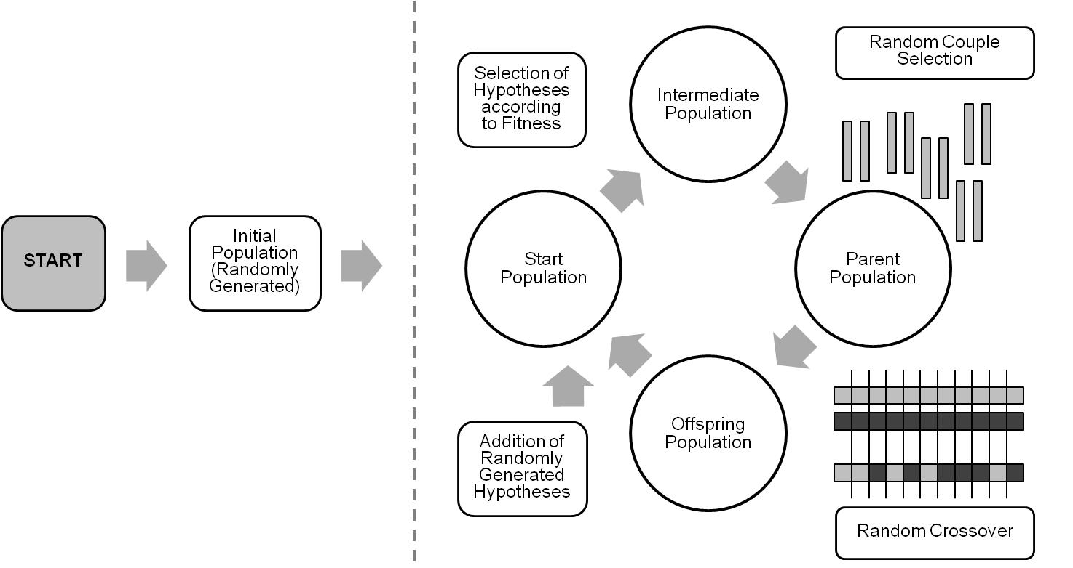
Modeling of complex biological systems Genetic algorithm
Schematic workflow of the embedded genetic algorithm. The procedure starts by randomly generating an initial population, which then enters the optimization cycle as the first start population. Within the cycle the selection of hypotheses according to fitness, randomly selection of couples, the generation of offspring population, and the formation of the next generation start population is repeated.

