Slide 1

Het ‘worldwide LHC Computing
Grid’, delen met velen
Jos Engelen
‘BiG Grid and beyond’, Beurs van Berlage,
Amsterdam, September 26, 2012

Slide 2

Accelerator and Experiments
Underground
circular tunnel
27 km circum-
ference; 100 m
underground
4 caverns for
experiments (•)
•
x
CMS
BD
x
RF
x
x
•
LHCb
ALICE
•
•
ATLAS

Slide 3
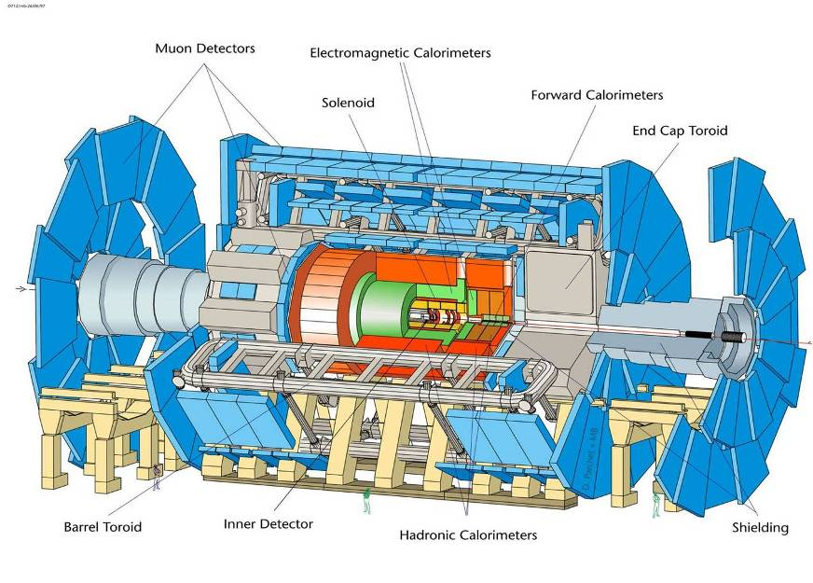
Botsende bundels
.,..,,,...
,,..,.,.,.
..
.,..,,,...
,,..,.,.,.
..
.,
..,..,,,...
,,..,.,.,..
..
.,..,,,...
,,..,.,.,.
..
.,..,,,...
,,..,.,.,.
..
.,
..,..,,,...
,,..,.,.,..
..
.,
..,..,,,...
,,..,.,.,..
..
.,
..,..,,,...
,,..,.,.,..
..
25 m
10⁻¹⁵m
46 m
De detector ziet 1 miljard botsingen per seconde, er worden honderden
deeltjes per botsing geproduceerd; snelle en stralingsbestendige de-
tectoren en electronica sturen de signalen naar het ‘on line’ computer-
systeen dat 150 ‘events’ (150 MBytes) per seconde opslaat.

Slide 4
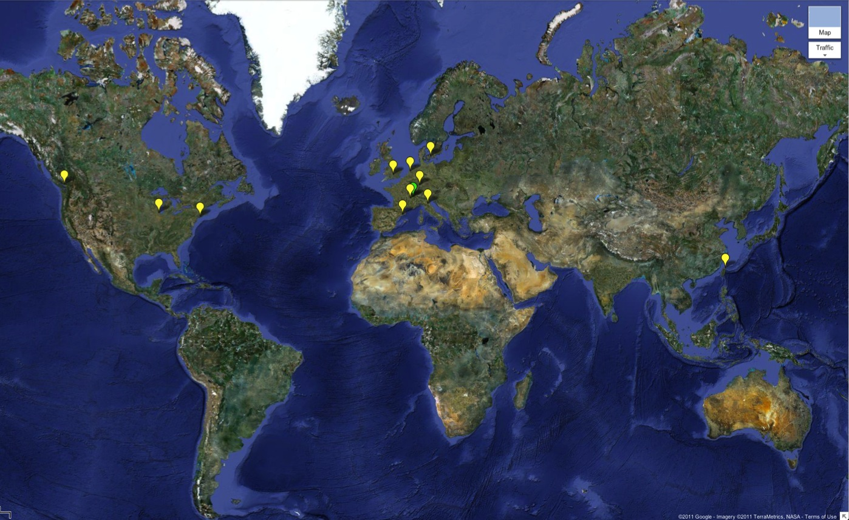

WLCG Grid Sites
Today >140 sites
>250k CPU cores
>150 PB disk
Tier 0
Tier 1
Tier 2

Slide 5
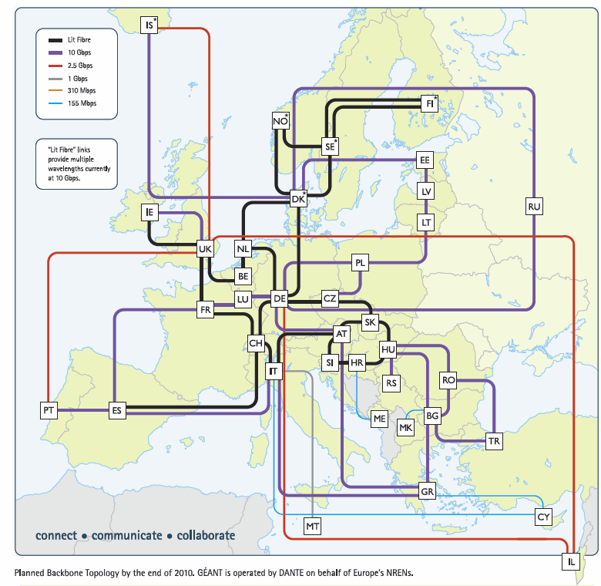
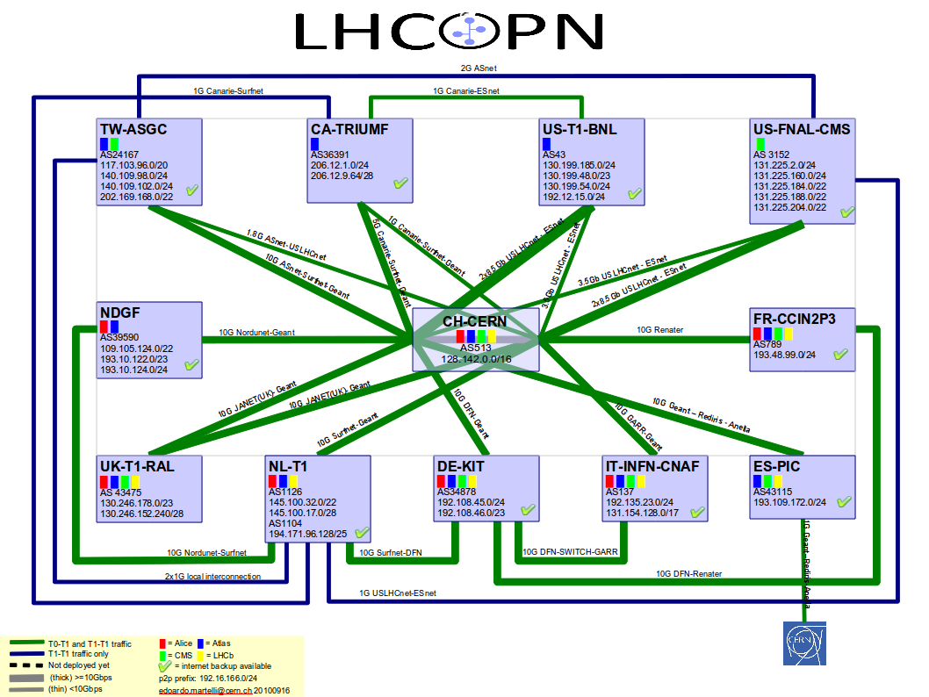
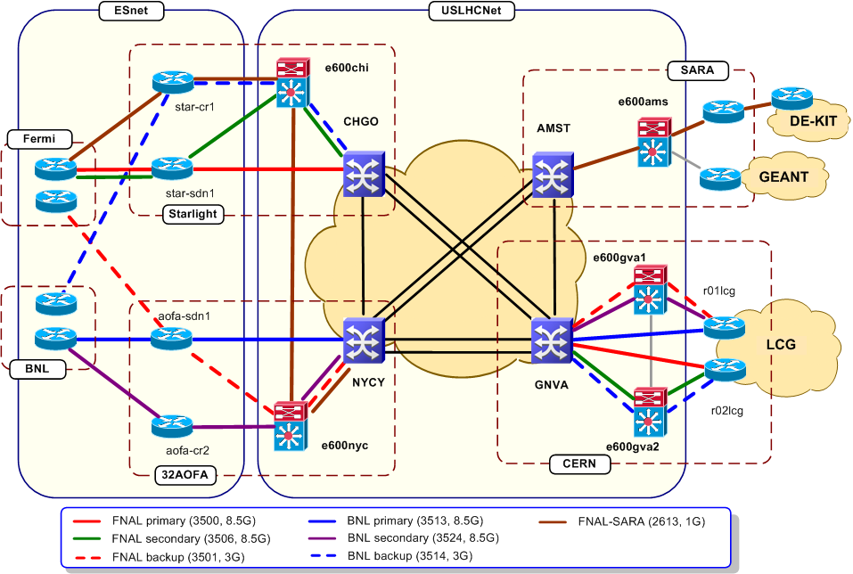
LHC Networking
Relies on
  OPN, GEANT, US-LHCNet
  NRENs & other national & international providers

Slide 6
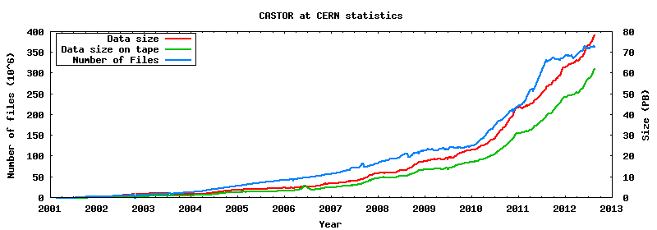
Data in Tier 0
62 PB on tape
370 M files
In 2010+2011 ~38 PB of data have been accumulated, expect about 30 PB more in 2012
2 PB/month in 2011;
3.5 PB/month in 2012 (1 PB/week)
More in HI runs
>30 PB in 2012?
15 PB in 2010
23 PB in 2011
p-p data
Pb-Pb data

Slide 7
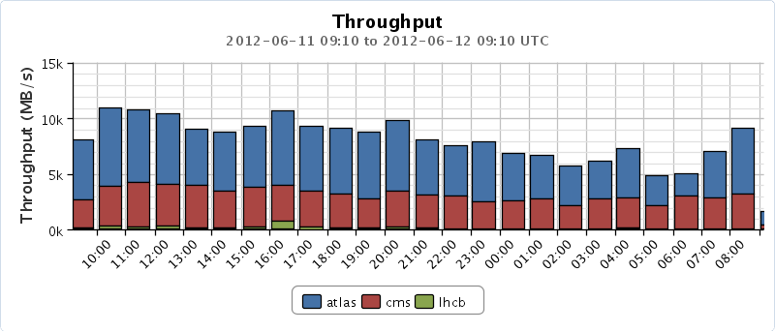
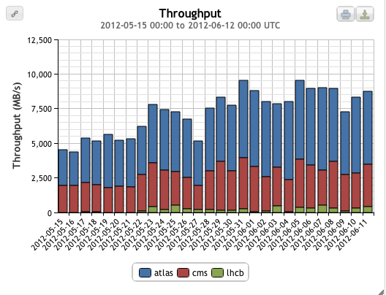
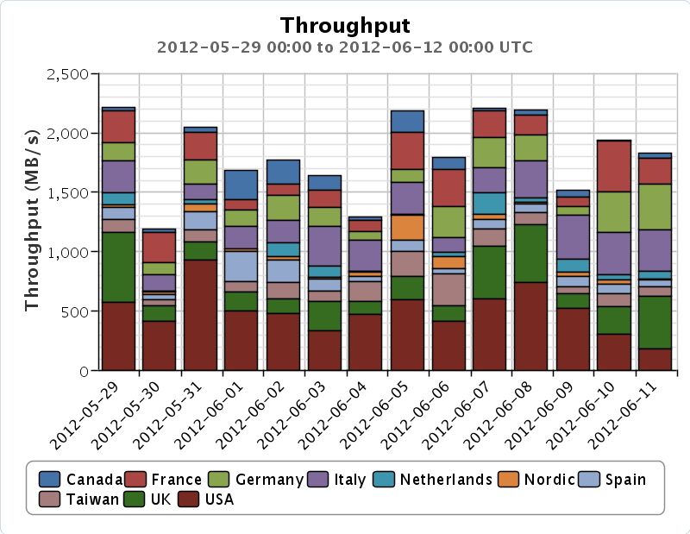
Data transfers
Global transfers (May-June)
Global transfers > 10 GB/s (1 day)
CERN → Tier 1s (with LHC on): 2 GB/s
Planned rates:
Tier 0 – Tier 1: 650 MB/s + margin

Slide 8
Processing on the grid
Usage continues to grow…
# jobs/day
CPU usage
1.5M jobs/day
~ 150,000 years of CPU delivered each year
10⁹ HEPSPEC-hours/month
(~150 k CPU continuous use)
This is close to full capacity
We always need more!

Slide 9
CPU – around the Tiers
The grid really works
All sites, large and small can contribute
  And their contributions are needed!
Notes:
The distribution of delivered CPU between the various tiers has also been according to the design, with tier 2s providing in excess of 50% of the total. If this is broken down we see that countries deliver close to what they pledged. Thus the grid concept really does work on this scale, and enables institutes worldwide to collaborate, share data, and provide resources to the common goals of the collaboration. Early worries that people would simply ignore the grid and use CERN for analysis were unfounded – Tier 2s are used extensively and exclusively.

Slide 10
Data analysis
Big Data Analytics requires a solid organisational structure at all levels
Must avoid “Big Headaches”
  Enormous files sizes and/or enormous file counts
  Data movement, placement, access pattern, life cycle
  Replicas, Backup copies, etc.
Big Data also implies Big Transactions/Transaction rates
The LHC community started preparing more than a decade before real physics data arrived
  Now, the situation is well under control
  But, data rates will continue to increase (dramatically) for years to come

Slide 11

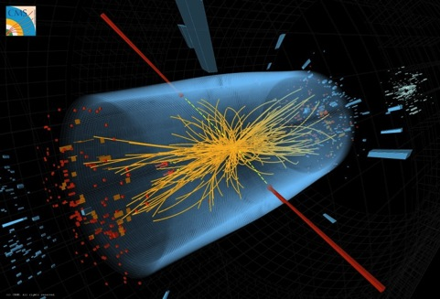
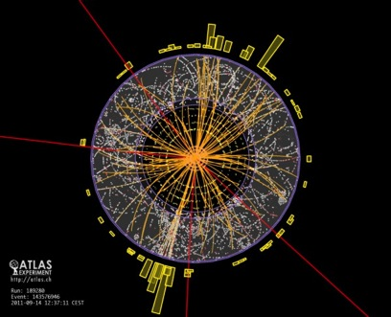
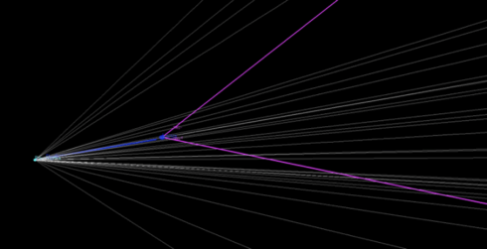
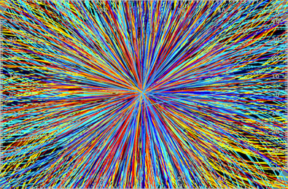
LHC + Experiments: spectacular start-up on 30 March 2010
Brilliant performances of LHC, experiments and GRID computing during 2010 and 2011 data taking periods
CMS
ATLAS
LHCb
Bº_{s} → μ+μ−
ALICE: Pb-Pb
2012 run:
energy increase (7 TeV → 8 TeV), factor 3 more data expected from LHC

Slide 12
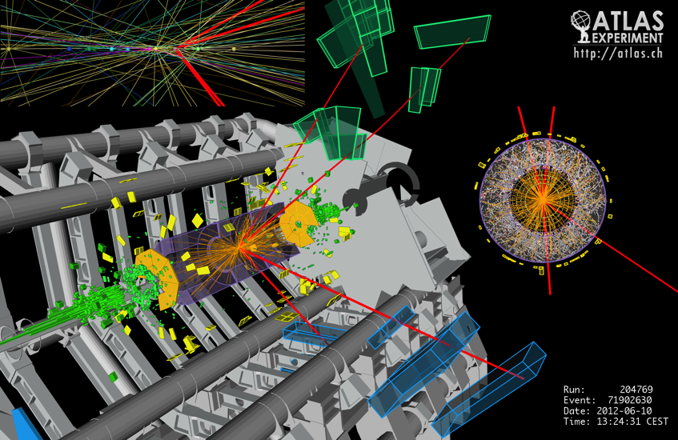
  Grid computing enables the rapid delivery of physics results

Slide 13
Impact of the LHC Computing Grid
WLCG has been leveraged on both sides of the Atlantic, to benefit the wider scientific community
  Europe:
    Enabling Grids for E-sciencE
    (EGEE) 2004-2010
    European Grid Infrastructure
    (EGI) 2010--
  USA:
    Open Science Grid (OSG)
    2006-2012 (+ extension?)
Many scientific applications ➔
  Archeology
  Astronomy
  Astrophysics
  Civil Protection
  Comp. Chemistry
  Earth Sciences
  Finance
  Fusion
  Geophysics
  High Energy Physics
  Life Sciences
  Multimedia
  Material Sciences
  …
Notes:
WLCG has driven the development of multi-science grids in Europe and in the US. In Europe the EGEE projects, followed recently by EGI support very many different applications other than LHC, while in the US the Open Science Grid has played a similar role, although also with LHC as a main stakeholder. In both cases many different application communities have benefitted from the advent of grid infrastructures.

Slide 14
Growth and evolution
WLCG – a 10 year program of development and implementation
Today the WLCG grid has delivered on its promise and LHC is producing unprecedented physics output
BUT: challenges remain!
  We have a >20 year program for the LHC and experiments
  Technology evolves: grids, clouds, CDN’s etc
  Physics hunger for resources continues to increase!

Slide 15
Evolution of capacity: CERN & WLCG
Modest growth until 2014
Anticipate x5 requirement >2015
Anticipate x10-100 after 2018
What we thought was needed at LHC start
What we actually used at LHC start!

